Slide 1

Movie recommendation System – Project
Review
MOVIE RECOMMENDATION SYSTEM
Team No : 1
Team Members :
Nalam Ramya [24B11CS308]
Nalam Sowmya [24B11CS309]
Tanuku Kusuma [24B11CS435]
Tanuku Yamuna [24B1CS436]

Slide 2
Movie recommendation System – Project
Review
Table of Contents
Abstract
Problem Statement
Objectives
Existing System vs Proposed System
Technologies Used
Dataset Description
System Architecture
Machine Learning Algorithms
Main Modules
Results and Output
Future Enhancements
Conclusion

Slide 3

ABSTRACT
The Movie Recommendation System is a machine learning-based application developed to help users discover movies according to their interests and preferences. In today's digital world, a large number of movies are available across different platforms, making it difficult for users to select movies that match their tastes. This project aims to solve this problem by providing relevant movie suggestions automatically based on movie features and user inputs.
The system analyzes various movie attributes, including title, genres, keywords, cast, director, ratings, and popularity. It uses TF-IDF (Term Frequency–Inverse Document Frequency) to convert textual movie information into numerical features. Cosine similarity and the k-Nearest Neighbors (kNN) algorithm are used to identify and recommend movies that are similar to a selected movie. Additionally, K-Means clustering is applied to group movies based on their ratings and popularity, helping users explore different categories of movies.
The recommendation results are ranked using text similarity and movie ratings. Overall, this project demonstrates the practical application of machine learning, text processing, and data analysis to build a movie recommendation system that simplifies movie selection and improves the movie discovery experience.

Slide 4
PROBLEM STATEMENT
Nowadays, thousands of movies are available on various digital platforms, making it difficult for users to select movies according to their interests. Searching manually through different movie categories, descriptions, and ratings requires considerable time and effort. Users may also miss interesting movies because they are unaware of films similar to their favourite movies.
Traditional searching methods may not consider multiple features, such as genres, keywords, cast, director, and user preferences, when suggesting movies. Moreover, popular or highly rated movies may not always match every user's taste. Finding movies based on specific interests, such as action, thriller, comedy, or science fiction, can also be challenging.
Therefore, there is a need for an automated movie recommendation system that analyzes movie features, identifies similarities between movies, and provides relevant suggestions. This project uses machine learning techniques such as TF-IDF, cosine similarity, kNN, and K-Means clustering to recommend similar movies, generate preference-based suggestions, and group movies based on ratings and popularity through an interactive Streamlit application.

Slide 5
OBJECTIVES
To develop a machine learning-based movie recommendation system.
To recommend similar movies based on a selected movie.
To generate movie suggestions based on user-entered preferences.
To analyze movie features such as genres, keywords, cast, and director.
To use TF-IDF to convert textual movie information into numerical features.
To apply cosine similarity and kNN to identify similar movies.
To use K-Means clustering to group movies based on ratings and popularity.
To rank movie recommendations using text similarity and movie ratings.
To develop a simple and interactive web application using Streamlit for displaying recommendations.

Slide 6
Existing System vs Proposed System
Existing system | Proposed system
Manual movie searching | Automated recommendations
Users browse many movies | Users receive ranked suggestions
Limited personalization | Supports text-based preferences
Difficult to explore related movies | Finds similar movies using ML
No dedicated grouping feature | Groups movies into clusters

Slide 7




Technologies Used
Python
Main programming language used to implement the recommendation logic.
Scikit-learn
Used for TF-IDF, cosine similarity, nearest neighbors, scaling and clustering.
Pandas and NumPy
Used for handling, processing and analyzing movie data.
Streamlit
Creates the interactive web interface for selecting movies and viewing
recommendations.

Slide 8
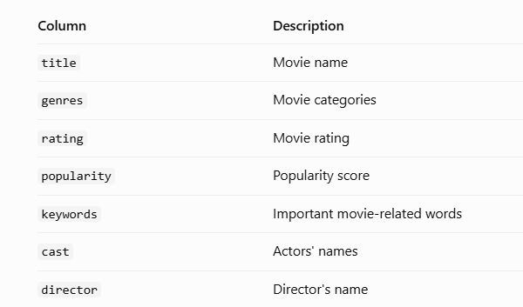
Dataset Description
The project uses a sample dataset stored in data/movies.csv.
Number of movie records: 50
Number of columns: 7

Slide 9
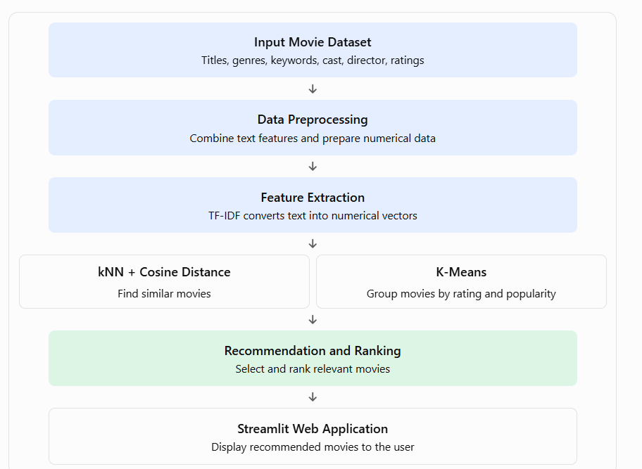
System Architecture

Slide 10
Machine Learning Algorithms Used
1. TF-IDF (Term Frequency–Inverse Document Frequency)
TF-IDF is a text-processing technique used to convert movie-related text into numerical vectors.
It analyzes information such as genres, keywords, cast, and director.
It assigns higher importance to words that help distinguish movies from others.
These numerical vectors help the system compare movie features.
In this project, TF-IDF is used to prepare text data for movie recommendations.
2. Cosine Similarity
Cosine similarity measures the similarity between two numerical text vectors.
It calculates the cosine of the angle between the vectors.
A score closer to 1 indicates greater similarity, while a score closer to 0 indicates less similarity for typical non-negative TF-IDF vectors.
It helps identify movies with similar genres, keywords, and other text features.
In this project, cosine distance is also used to find the nearest matching movies.

Slide 11
Machine Learning Algorithms Used
3. k-Nearest Neighbors (kNN)
kNN is a machine learning algorithm used to find the nearest data points to a selected item.
It compares movies using their TF-IDF feature vectors.
The cosine distance metric helps identify movies with similar textual features.
The algorithm returns the nearest movies based on the selected movie.
In this project, kNN is used to recommend movies similar to the user's selection.
4. K-Means Clustering
K-Means is an unsupervised machine learning algorithm used to group similar data points into clusters.
It divides the movie dataset into five clusters based on rating and popularity.
The algorithm groups movies according to similarities in these numerical features.
Feature scaling helps prevent differences in numerical ranges from dominating the clustering.
In this project, users can select a cluster to explore its movies and characteristics.

Slide 12
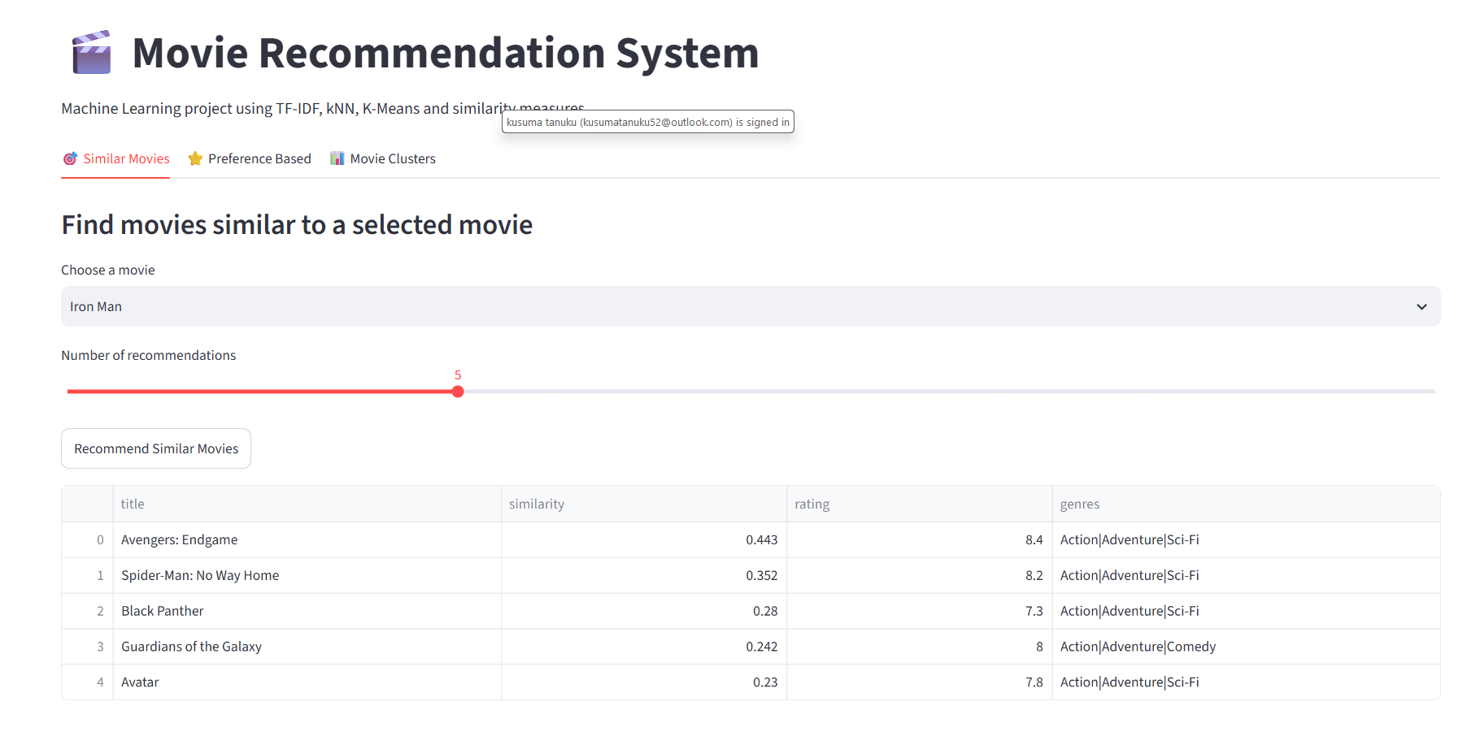
Main Modules

Slide 13
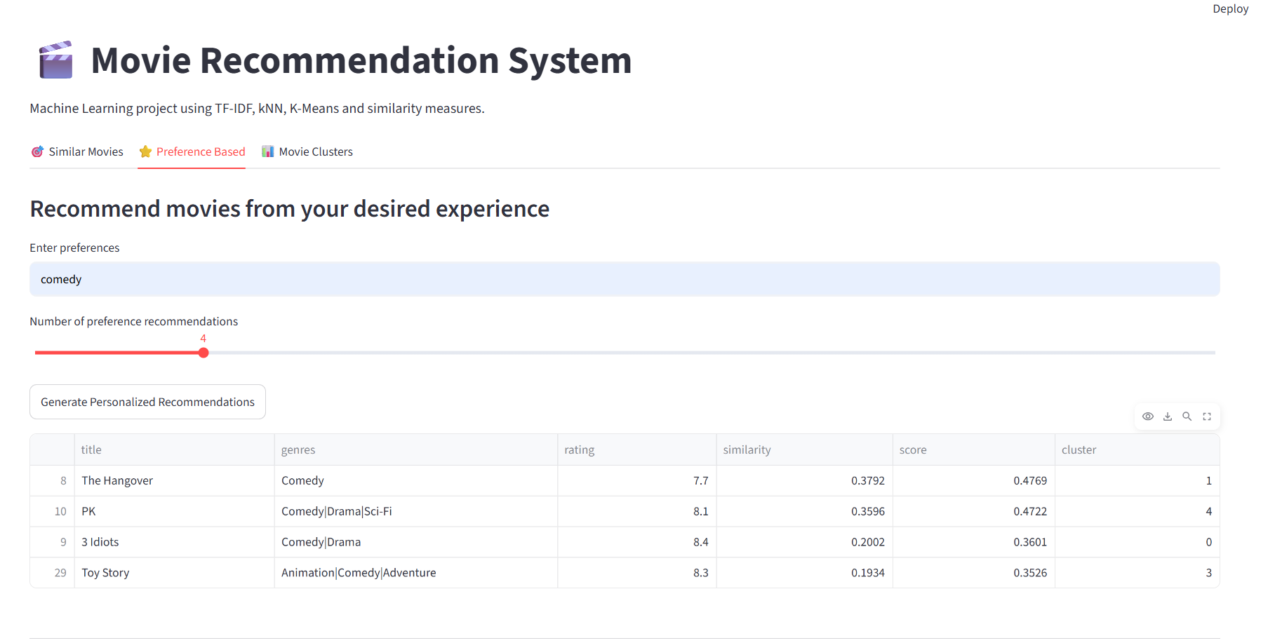
Main Modules

Slide 14
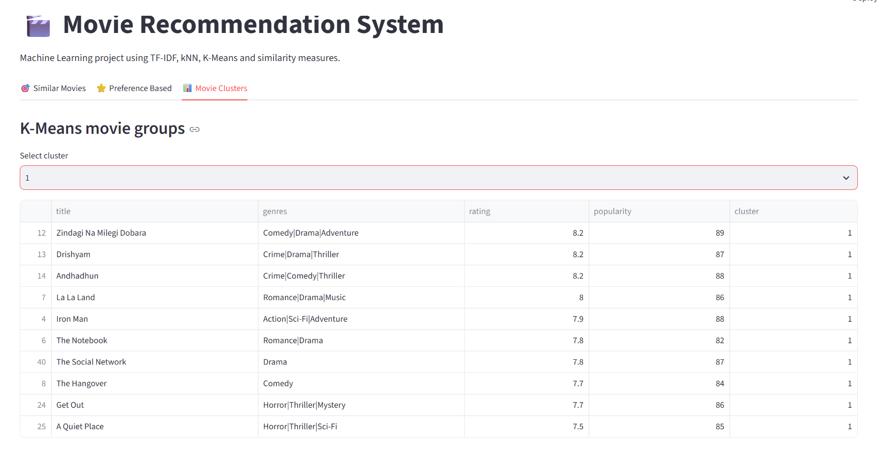
Main Modules

Slide 15
Results and Output
The Movie Recommendation System successfully provides movie suggestions using machine learning techniques. When a user selects a movie, the system identifies similar movies based on their genres, keywords, cast, and director using TF-IDF, cosine similarity, and the k-Nearest Neighbors algorithm. Users can also enter their interests and receive ranked movie recommendations based on text similarity and movie ratings.
The application also groups movies into five clusters using the K-Means clustering algorithm based on ratings and popularity. The results are displayed through an interactive Streamlit web interface, allowing users to explore similar movies, preference-based recommendations, and movie clusters. Overall, the system simplifies movie discovery and demonstrates the practical application of machine learning in recommendation systems

Slide 16
Future Enhancements
In the future, the Movie Recommendation System can be improved by using a larger and regularly updated movie dataset to provide more diverse and relevant recommendations. Additional features such as movie posters, trailers, detailed descriptions, user accounts, and personalized watchlists can be introduced to make the application more interactive and user-friendly. The system can also be enhanced to learn from users' ratings, viewing history, and feedback to understand their interests better.
Furthermore, content-based filtering can be combined with collaborative filtering to generate more personalized recommendations. The performance of the system can be evaluated using metrics such as Precision@K and Recall@K to measure recommendation quality. Finally, the application can be deployed online so that users can access the Movie Recommendation System from anywhere and enjoy an improved movie discovery experience.

Slide 17
Conclusion
The Movie Recommendation System using Machine Learning provides an effective way to help users discover movies according to their interests and preferences. The system uses TF-IDF, cosine similarity, and the k-Nearest Neighbors algorithm to identify similar movies and generate preference-based recommendations. It also applies K-Means clustering to group movies based on their ratings and popularity. These techniques demonstrate how machine learning can be used to analyze movie data and provide meaningful suggestions.
The application is developed using Python and Streamlit, providing a simple and interactive interface for users to explore movie recommendations. This project reduces the effort required to search for suitable movies and improves the movie discovery process. Overall, the project provides practical experience in machine learning, text processing, data analysis, and web application development, while offering opportunities for future improvements and more personalized recommendations.
.

